Slide 1
CSE- 3rd Semester
COMPUTER ARCHITECTURE & ORGANIZATION
Notes:
Manav Rachna College of Engineering

Slide 2
Memory Organization

Slide 3
Memory Hierarchies
Auxiliary Memory
Magnetic
Tapes
I/O
Processor
Main
Memory
Magnetic Disk
Cache
Memory
CPU

Slide 4
Memory Hierarchies
Some fundamental and enduring properties of hardware and software:
  Fast storage technologies cost more per byte and have less capacity.
  The gap between CPU and main memory speed is widening.
These fundamental properties complement each other beautifully.
They suggest an approach for organizing memory and storage systems known as a Memory hierarchy. The memory hierarchy system consists of all the storage devices.

Slide 5
Need for Memory Hierarchy
Is to obtain the highest possible average access speed while minimizing the total cost of the entire memory system.

Slide 6
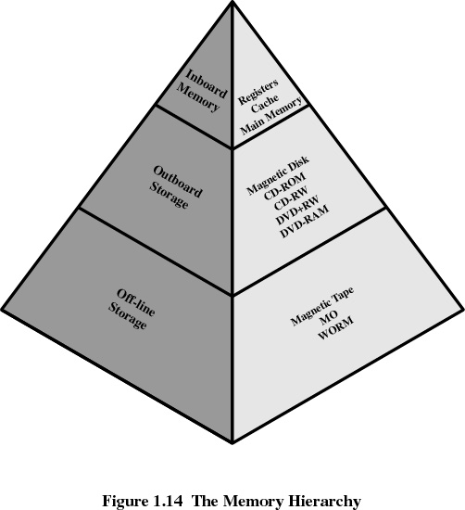
Memory Hierarchy

Slide 7
An Example Memory Hierarchy
Smaller,
faster,
and
costlier
(per byte)
storage
devices
L0:
registers
CPU registers hold words retrieved from L1 cache.
L1:
on-chip L1
cache (SRAM)
L1 cache holds cache lines retrieved from the L2 cache memory.
L2:
off-chip L2
cache (SRAM)
L2 cache holds cache lines retrieved from main memory.
L3:
main memory
(DRAM)
Larger,
slower,
and
cheaper
(per byte)
storage
devices
Main memory holds disk
blocks retrieved from local
disks.
L4:
local secondary storage
(local disks)
Local disks hold files retrieved from disks on remote network servers.
L5:
remote secondary storage
(distributed file systems, Web servers)

Slide 8
Memory Performance
The goal of memory design is to increase memory bandwidth and decrease access time.
We take advantage of three principles of computing in order to achieve this goal:
Make the common case faster.
Smaller is Faster.
Principle of Locality.

Slide 9
Locality of Reference
In computer science, locality of reference, also known as the principle of locality, is the phenomenon of the same value or related storage locations being frequently accessed.
The most important property of all programs:
– programs tend to reuse data and instructions they have used recently
– such characteristics of programs are mainly due to code loops, and repeatedly accessing the same data structure (arrays, stacks, …)

Slide 10
Locality of Reference
The memory accesses generated by a processor tend to be restricted to small areas of main memory
– at any one time a program spends 90% of its execution time within 10% of its code
– this implies that we should be able to predict what instructions and data a program is likely to access in the near future based on its memory accesses in the recent past.
Locality is merely one type of predictable behavior that occurs in computer systems. Systems which exhibit strong locality of reference phenomenon, are good candidates for performance optimization through the use of techniques, like the cache and prefetching technology concerning the memory.

Slide 11
Locality of Reference
Except for branch and call instructions, program execution is sequential – the next instruction to be fetched immediately follows the current instruction.
Most loops consist of a relatively small number of instructions repeated many times: computation is, therefore, confined to small contiguous portions of a program for periods of time.
Most of the computation in many programs involves the processing of data structures, such as arrays or sequences of records. Successive references to these data structures will be to closely related data items.

Slide 12
Components of Locality
Temporal Locality
Temporal locality refers to the reuse of specific data and/or resources within relatively small time durations. If a location is referenced, there is a high likelihood that it will be referenced again in the near future (time). For example, loops, temporary variables, arrays, stacks, …
Spatial Locality
Spatial locality refers to the use of data elements within relatively close (neighborhood) storage locations. Sequential locality, a special case of spatial locality, occurs when data elements are arranged and accessed linearly, e.g., traversing the elements in a one-dimensional array. If you reference instruction or data at a certain location, there is a high likelihood that nearby addresses will also be referenced

Slide 13
Computer Memory
Two basic categories of computer memory: Primary storage and Secondary storage.
  Primary stores small amounts of data and information that will be immediately used by the CPU.
  Secondary stores much larger amounts of data and information (an entire software program, for example) for extended periods of time.

Slide 14
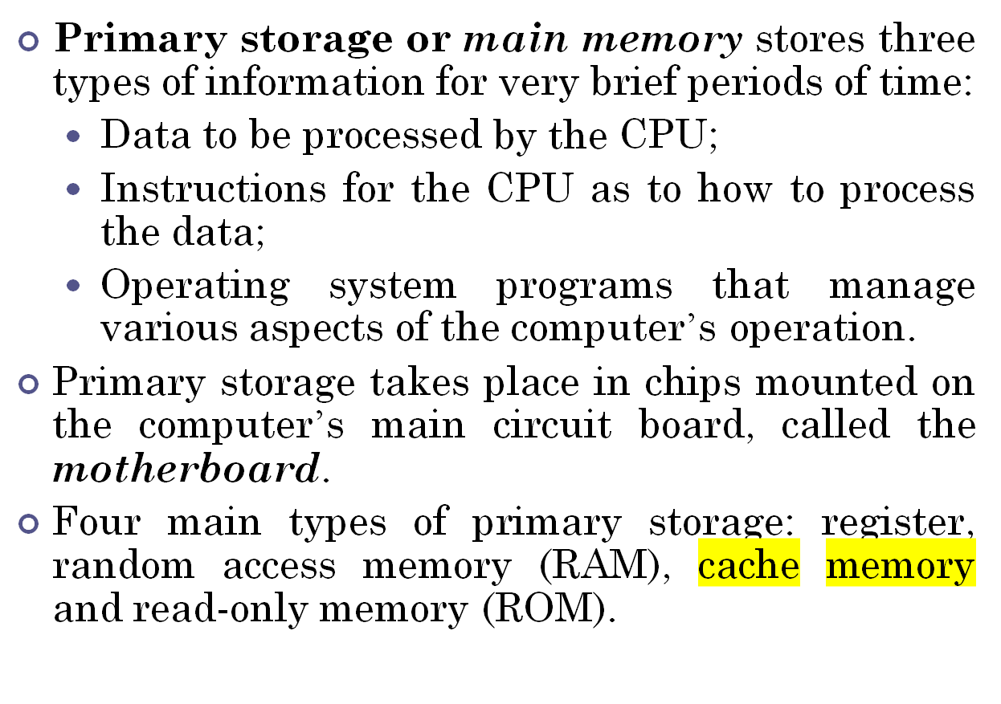
Primary Storage

Slide 15
Main Types of Primary Storage
Registers: registers are part of the CPU with the least capacity, storing extremely limited amounts of instructions and data only immediately before and after processing.
Random access memory (RAM): The part of primary storage that holds a software program and small amounts of data when they are brought from secondary storage.
Cache memory: A type of primary storage where the computer can temporarily store blocks of data used more often.
Read-only memory (ROM): Type of primary storage where certain critical instructions are safeguarded; the storage is nonvolatile and retains the instructions when the power to the computer is turned off.

Slide 16
Secondary Storage
Memory capacity that can store very large amounts of data for extended periods of time.
  It is nonvolatile.
  It takes much more time to retrieve data because of the electromechanical nature.
  It is cheaper than primary storage.
  It can take place on a variety of media

Slide 17
Secondary storage
Sequential access
Direct access
Magnetic tape
Magnetic disk
Optical disk
CD-ROM
WORM
Hard disk
Floppy disk

Slide 18
Secondary Storage (Continued)
Sequential access: Data access in which the computer system must run through data in sequence in order to locate a particular piece.
Direct access: Data access in which any piece of data be retrieved in a non-sequential manner by locating it using the data’s address.

Slide 19
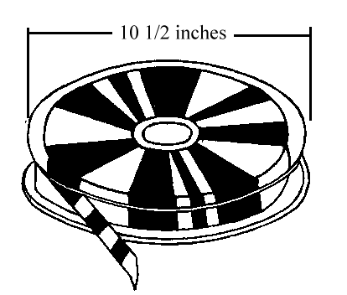
Magnetic tape: A secondary storage medium on a large open reel or in a smaller cartridge or cassette.
Magnetic tapes are used for large computers like mainframe computers where large volume of data is stored for a longer time.
The cost of storing data in tapes is inexpensive.
Tapes consist of magnetic materials that store data permanently. It can be 12.5 mm to 25 mm wide plastic film-type and 500 meter to 1200 meter long which is coated with magnetic material.

Slide 20
Secondary Storage (Continued)
Magnetic disks: A form of secondary storage on a magnetized disk divided into tracks and sectors that provide addresses for various pieces of data; also called hard disks.
Each disk consists of a number of invisible concentric circles called tracks. Information is recorded on tracks of a disk surface in the form of tiny magnetic spots.
The presence of a magnetic spot represents one bit and its absence represents zero bit. The information stored in a disk can be read many times without affecting the stored data.

Slide 21
Secondary Storage (Continued)
Hard disk: A form of secondary storage that stores data on platters divided into concentric tracks and sectors, which can be read by a read/write head that pivots across the rotating disks.
Floppy disk: A form of easily portable secondary storage on flexible disks; also called floppy disks.

Slide 22
Optical Storage Devices
Optical storage devices: A form of secondary storage in which a laser reads the surface of a reflective plastic platter.
Compact disk, read-only memory (CD-ROM): A form of secondary storage that can be only read and not written on.
Digital video disk (DVD): An optical storage device used to store digital video or computer data.
Fluorescent multilayer disk (FMD-ROM): An optical storage device with much greater storage capacity than DVDs.

Slide 23
More Storage Options
Memory cards: Credit-card-size storage devices that can be installed in an adapter or slot in many personal computers (i.e. memory sticks, thumb drives).
Expandable storage devices: Removable disk cartridges, used as backup storage for internal hard drives of PCs.

Slide 24
Caches
The rate of data fetching by the CPU from the main memory is about 100 times faster than from secondary memory. But there is also a mismatch between main memory and CPU. CPU can process the data 10 times faster than the main memory. Which limits the performance of the CPU due to mismatch in CPU and main memory speed. So Cache memory act as a buffer b/w main memory and CPU.
Cache: A smaller, high speed storage device used to increase the speed of processing by making current programs and data available to the CPU at a rapid rate.
The basic characteristic of cache memory is its fast access time.

Slide 25
Cache Memory
Processor speed is faster than memory speed
Invisible to operating system
Increase the speed of memory
Contains a portion of main memory
Processor first checks cache
If not found in cache, the block of memory containing the needed information is moved to the cache

Slide 26
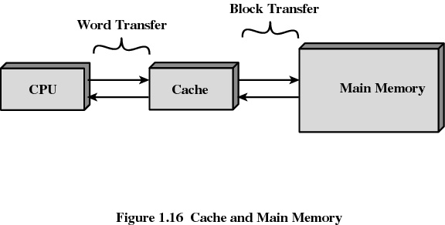
Cache Memory

Slide 27
Caches
Fundamental idea of a memory hierarchy:
  For each k, the faster, smaller device at level k serves as a cache for the larger, slower device at level k+1.
Why do memory hierarchies work?
  Programs tend to access the data at level k more often than they access the data at level k+1.
  Thus, the storage at level k+1 can be slower, and thus larger and cheaper per bit.

Slide 28
Caching in a Memory Hierarchy
Smaller, faster, more expensive
device at level k caches a
subset of the blocks from level k+1
8
Level k:
4
9
14
3
10
Data is copied between
levels in block-sized transfer units
10
4
0
1
2
3
4
Larger, slower, cheaper storage
device at level k+1 is partitioned
into blocks.
Level k+1:
4
5
6
7
8
9
10
10
11
12
13
14
15

Slide 29
General Caching Concepts
Program needs object d, which is stored in some block b.
Cache hit
  Program finds b in the cache at level k. E.g., block 14.
Cache miss
  b is not at level k, so level k cache must fetch it from level k+1. E.g., block 12.
  If level k cache is full, then some current block must be replaced (evicted). Which one is the “victim”?
  The Performance of cache is measured in terms of quantity called Hit ratio.
Request
12
14
Request
14
12
0
1
2
3
Level
k:
4*
9
14
12
14
3
4*
12
Request
12
4*
0
1
2
3
Level
k+1:
4
5
6
7
4*
8
9
10
11
12
13
14
15
12

Slide 30
Hit Ratio is the ratio of the number of hits divided by the total CPU references to memory (hits plus misses).
If the hit ratio is high enough so that most of the time the CPU access the cache instead the main memory.
Hit Ratio= Cache hits
Cache hit + Cache miss

Slide 31
Cache Design
Cache size
  small caches have a significant impact on performance
Block size
  the unit of data exchanged between cache and main memory
  hit means the information was found in the cache
  larger block size more hits until probability of using newly fetched data becomes less than the probability of reusing data that has been moved out of cache

Slide 32
Cache Design
Mapping function
  determines which cache location the block will occupy
Replacement algorithm: determines which block to replace
  Least-Recently-Used (LRU) algorithm
  FIFO
  Random replacement

Slide 33
WRITING INTO CACHE
Write through
Write Back

Slide 34
Cache Organization
The Transformation of data from main memory to Fully cache memory is referred to as a mapping process. Three types of mapping procedures are:
Fully Associative mapping: The most flexible
Direct Mapped mapping : The most basic
Set Associative mapping : A combination of the two

Slide 35
ASSOCIATIVE MEMORY
Searching a block of memory (such as an array) for a particular value is such a common operation that, in some cases, it warrants a hardware-based solution.
An associative memory, also known as content-addressable memory (CAM) can be searched for a value in a single memory cycle rather than using a software loop.

Slide 36
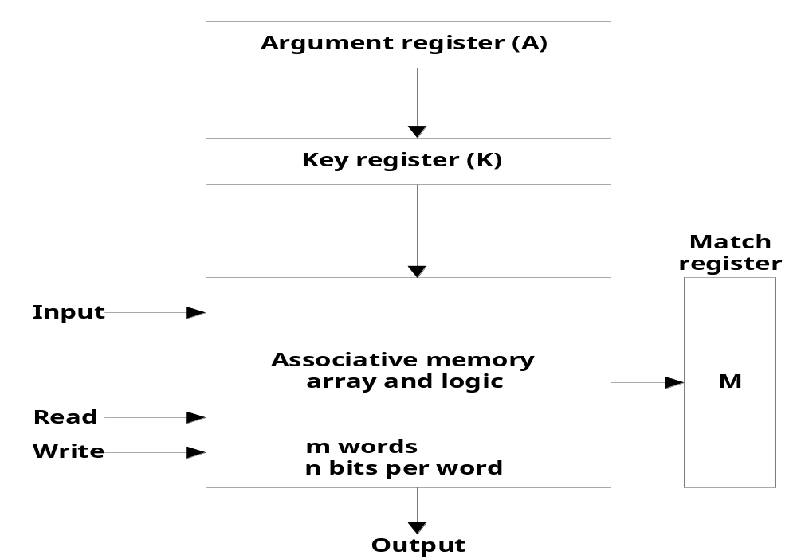
ASSOCIATIVE MEMORY

Slide 37
The argument register contains the value to search for, and therefore is n bits wide to match the size of a word in the memory.
The key register holds a mask that allows searching based on part of argument. If a bit in the key register is 1, then the corresponding bit in the argument and each memory word must be the same to be considered a match. If a bit in the key register is 0, then the corresponding bit is considered a match whether or not the argument and memory word are equal for that bit. This allows searches for words where any subset of the bits match the argument register.
The match register, M, is m bits wide (could be huge), and will contain a 1 for each word that matches the masked argument, and a 0 for each word that does not.

Slide 38
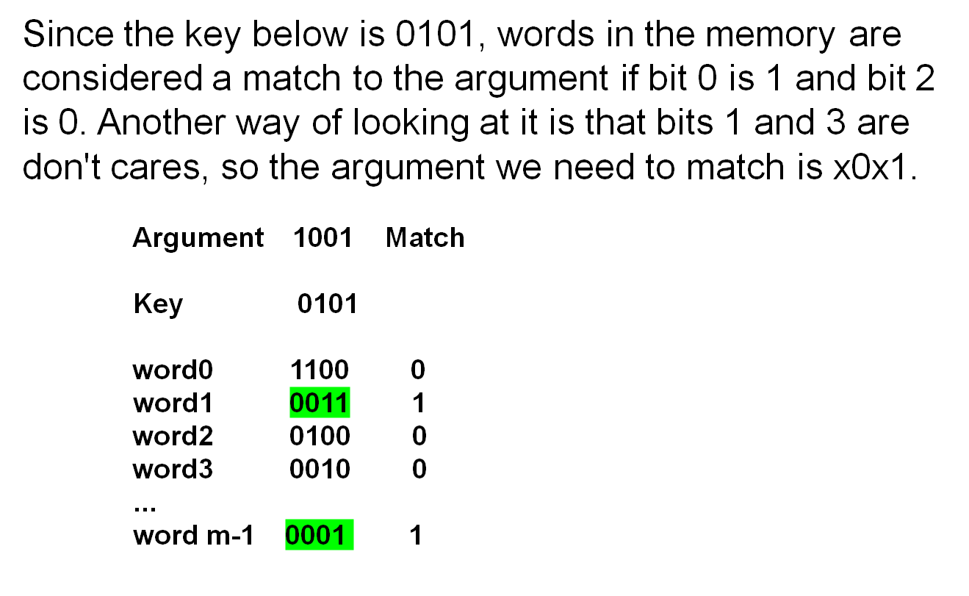
EXAMPLE OF ASSOCIATIVE MEMORY

Slide 39
APPLICATIONS
Associative memory is more expensive than a random access memory because each cell must have storage capacity as well as a logic circuit for matching its content with an external argument.
Used in applications where the search time is very critical and must be very short.

Slide 40
MEMORY ORGANIZATION FOR MAPPING
Main Memory 32K x 12
CPU
Cache Memory
512 x 12

Slide 41
Fully Associative
In a fully associative cache subsystem, the cache controller can place a block of bytes in any of the available cache lines.
The fastest and most flexible cache organization uses an associative Memory.
Stores both address and content(data) of memory word.

Slide 42
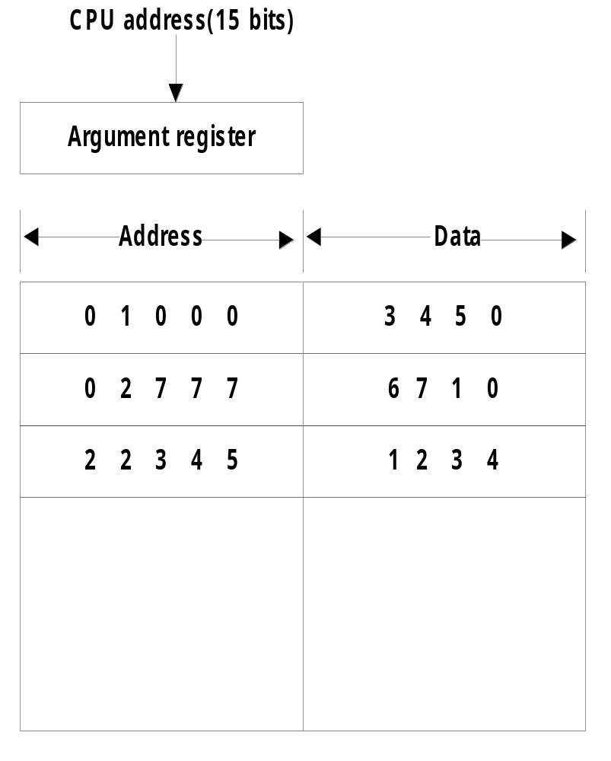
Fully Associative

Slide 43
Direct Mapped
Associative memories are expensive compared to RAM. The possibility of using a RAM for cache is Direct mapping.
In general, there are 2^{k} words in cache and 2^{n} words in main memory. The n-bit memory address is divided into two fields : k bits for the index field and n-k bits for the tag field.

Slide 44
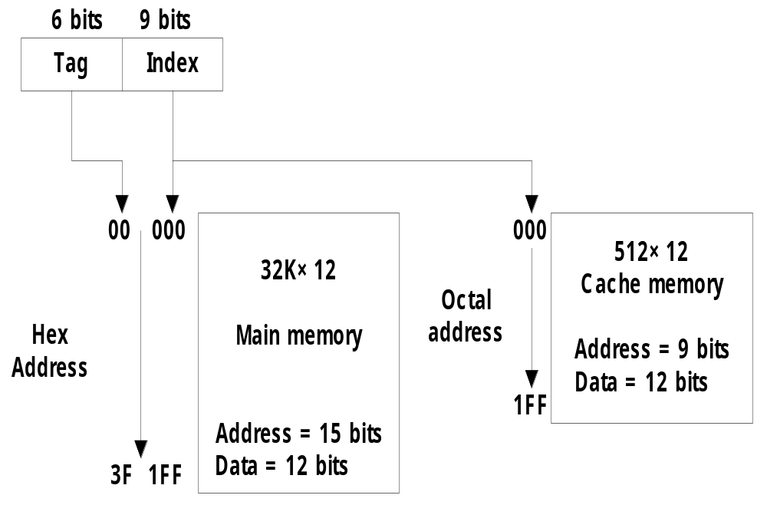
Direct Mapped
Manav Rachna College of Engg.
Tag (6 bit)
00 - 63
Index (9 bit)
000 - 511

Slide 45
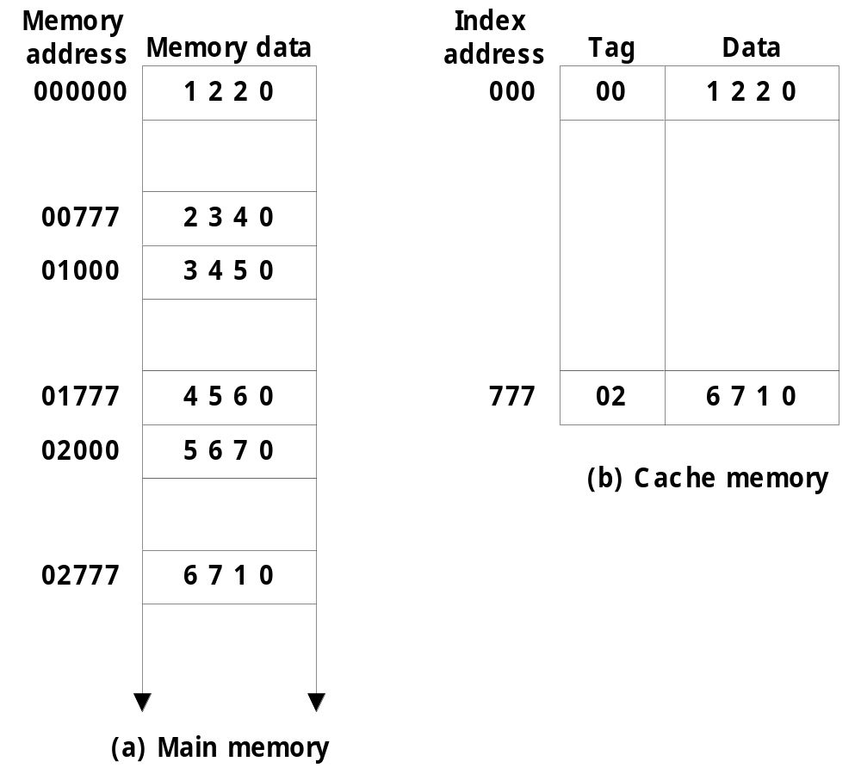
Manav Rachna College of Engg.

Slide 46
Disadvantage of Direct mapping
Hit ratio can drop if two or more words whose addresses have the same index but different tags are accessed repeatedly.

Slide 47
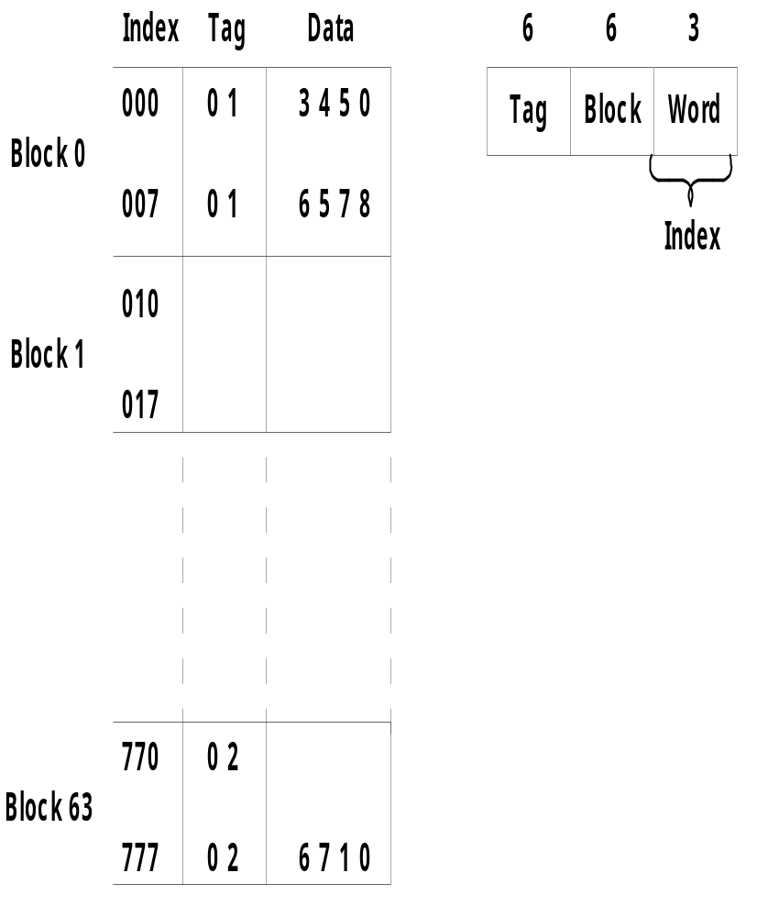
Manav Rachna College of Engg.

Slide 48
Set Associative
Improvement over direct mapping organization in that each word of cache can store two or more words of memory under the same index address.

Slide 49
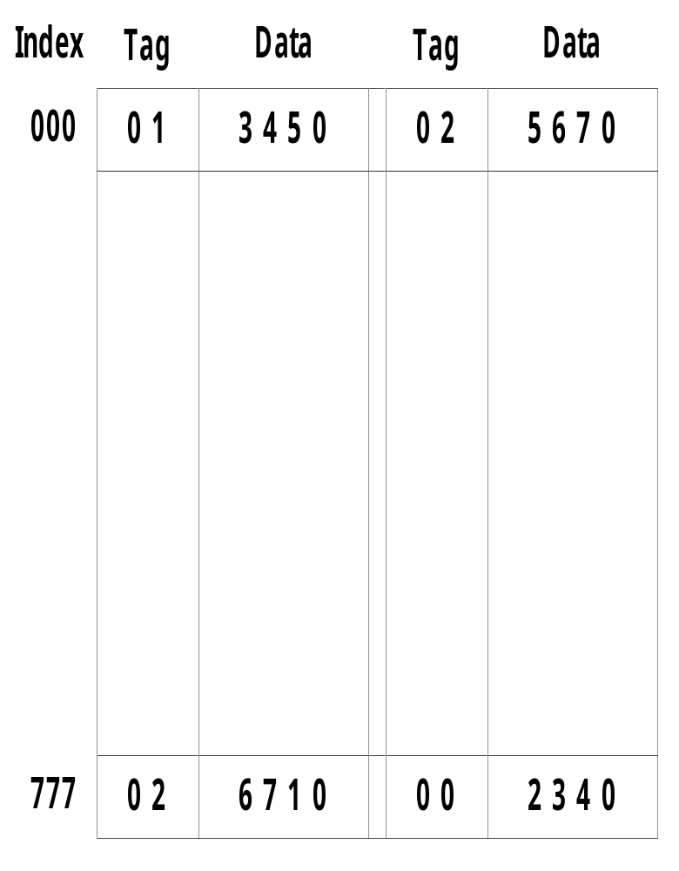
Set Associative
Manav Rachna College of Engg.

Slide 50
Random-Access Memory (RAM)
Key features
  RAM is packaged as a chip.
  Basic storage unit is a cell (one bit per cell).
  Multiple RAM chips form a memory.
Static RAM (SRAM)
  Each cell stores bit with a six-transistor circuit.
  Retains value indefinitely, as long as it is kept powered.
  Relatively insensitive to disturbances such as electrical noise.
  Faster and more expensive than DRAM.
Dynamic RAM (DRAM)
  Each cell stores bit with a capacitor and transistor.
  Value must be refreshed every 10-100 ms.
  Sensitive to disturbances.
  Slower and cheaper than SRAM.

Slide 51
Read-Only Memory (ROM)
Key Features
  Performs the Read operations only.
  Used to store programs that are permanently resident in the computer & tables of constants.
  Used for storing an initial program called a bootstrap loader.
Masked programmed
User programmed
1. PROM
2. EPROM
3. EEPROM(EAPROM)
Notes:
Manav Rachna College of Engineering

Slide 52
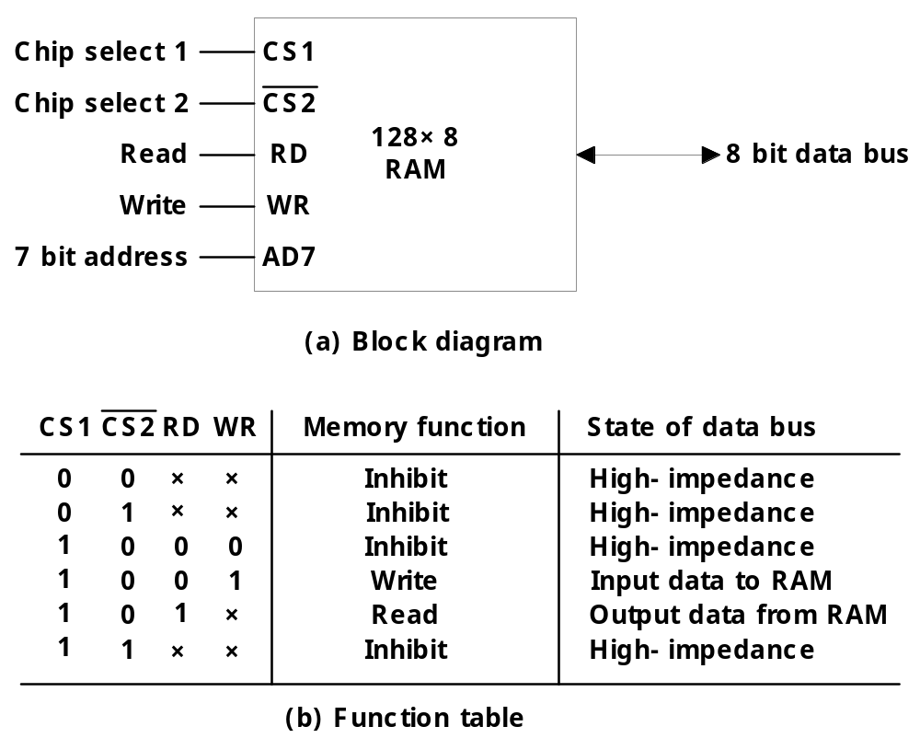
RAM CHIP

Slide 53
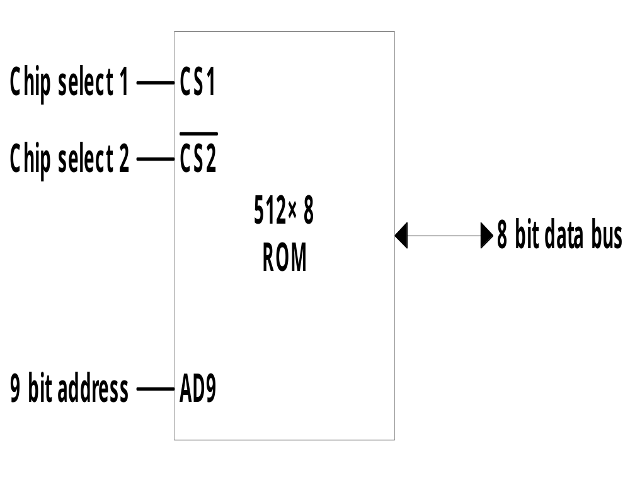
ROM CHIP

Slide 54
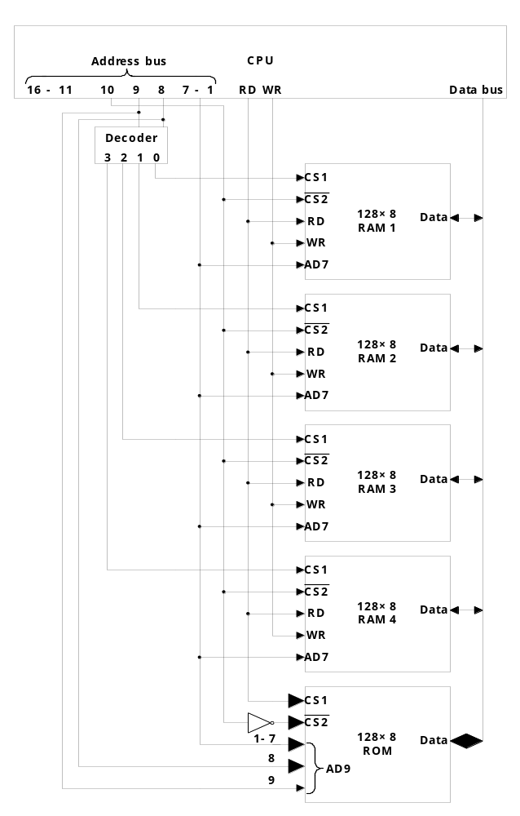
MEMORY EXPANSION
Manav Rachna College of Engg.

Slide 55
  Memory Address Map
    Memory Configuration : 128 bytes of 4 RAM + 512 bytes ROM
      1 x 512 byte ROM + 4 x 128 bytes RAM
    Memory Address Map :
    Address line 9 8
        RAM 1 0 0 : 0000 - 007F
        RAM 2 0 1 : 0080 - 00FF
        RAM 3 1 0 : 0100 - 017F
        RAM 4 1 1 : 0180 - 01FF
      Address line 10
        ROM 1 : 0200 - 03FF
    Memory Connection to CPU :
    2 x 4 Decoder : RAM select (CS1)
      Address line 10
        RAM select : CS2
        ROM select : CS2
Notes:
Manav Rachna College of Engineering

